Slide 1
PSCS_46_Application for Assessment of Quality of Textbook/ Reference Books/E-Books
CSE7101- Capstone Project
Review-2
Batch Number : CIT_35
Under the Supervision of,
Dr./Mr./Ms./Prof. Dr.Mohammad Buran Basha and Ms.Bhavya B
Professor / Associate Professor / Assistant Professor
School of Computer Science and Engineering
Presidency University
20221CIT0142 | Preetu P R
20221CIT0118 | Tanuj Kumar
20221CIT0134 | Chakravarthi
Roll Number | Student Name
Name of the Program : CIT
Name of the HoD : Dr. Anandaraj S P
Name of the Program Project Coordinator : Dr. Sharmasth Vali
Name of the School Project Coordinators : Dr.Sampath A K , Dr. Geetha A

Slide 2
Content
Abstract
Literature Survey
Objectives
Existing Methods & Feasibility Study
Proposed Method & Feasibility Study
Architecture Diagram
Modules
Hardware and Software Details
Timeline of the Project
References

Slide 3
Abstract
The medical students aiming to be good physicians, need to select a standard
medical textbook. It is evident that there are several books made available in ASU
(Ayurveda, Unani, Siddha) medical systems and every book claims that the book has
been written as per CCIM or NCISM syllabus. Amongst some are good and some are
of poor uality and were written with vested interest.
Due to this, students are
trapped by substandard books that leads to poor quality standard among students.
Identifying this issue and its impact on medical on the medical system, NCISM
constituted an expert committee for the development of an assessment scale for
textbooks/ reference books. The expert committee after thorough deliberations
developed the assessment scale for the quality assessment of textbooks/ reference
books.

Slide 4
Literature Survey
Existing Studies:
Textbook Quality Evaluation Frameworks (IOSR, 2019) → emphasizes content clarity, readability, and design.
Evaluating Digital Textbooks in Higher Education (ScienceDirect, 2021) → highlights accessibility and interactive features.
Readability Analysis of Mathematics Textbooks (IJR, 2020) → shows how readability scores impact comprehension.
Gap Identified: Current methods lack automation, rely heavily on human judgment, and do not fully support e-books.

Slide 5
Problem Statement Number : PSCS_46
The medical students aiming to be good physicians, need to select a standard
medical textbook. It is evident that there are several books made available in ASU
(Ayurveda, Unani, Siddha) medical systems and every book claims that the book has
been written as per CCIM or NCISM syllabus. Amongst some are good and some are
of poor uality and were written with vested interest.
Due to this, students are
trapped by substandard books that leads to poor quality standard among students.
Identifying this issue and its impact on medical on the medical system, NCISM
constituted an expert committee for the development of an assessment scale for
textbooks/ reference books. The expert committee after thorough deliberations
developed the assessment scale for the quality assessment of textbooks/ reference
books.

Slide 6
Problem Statement : How it Works
Process for Assessment of Quality of Textbook / Reference Books / E-Book
Application Submission – Author or publisher submits details of the book.
Sample & Documents – Provide copy/link, author details, and syllabus relevance.
Expert Review – Panel evaluates content accuracy, relevance, and clarity.
Feedback – Suggestions or corrections if needed.
Approval – Certified and added to recommended reading list.

Slide 7
OBJECTIVES
Develop a centralized digital application for assessing the quality of textbooks, reference books, and e-books in ASU (Ayurveda, Unani, Siddha) medical systems.
Automate the review and evaluation process to save time, reduce human error, and ensure consistency.
Provide standardized evaluation criteria for subject experts and reviewers across the country.
Enable real-time feedback and scoring to improve transparency and accountability in book approvals.
Support teachers and students in selecting high-quality and syllabus-compliant textbooks.
Build a repository of approved books that can be recommended by regulatory bodies (CCIM/NCISM).

Slide 8
Existing Methods & Feasibility Study
Existing Methods: Manual evaluation by experts, surveys, readability tests (Flesch-Kincaid, Gunning Fog).
Challenges: Time-consuming, subjective, lack of scalability.
Feasibility: With NLP libraries, cloud storage, and cross-platform app frameworks, developing such an application is both cost-effective and technically achievable.

Slide 9
Proposed Method & Feasibility Study
Proposed System:
An application (web/mobile) that accepts a textbook/e-book or metadata as input.
Runs automated readability analysis, checks references, evaluates structure/design, and collects user ratings.
Produces a comprehensive quality score/report.
Feasibility:
Hardware requirements are minimal (standard PC/mobile).
Software libraries for NLP, sentiment analysis, and UI design are readily available.
Cloud-based deployment ensures scalability.

Slide 10
Background and Related work for title selection
Background
Textbooks are the main source of learning for medical students.
In ASU (Ayurveda, Unani, Siddha), many books claim to follow CCIM/NCISM syllabus, but some are of poor quality.
Students often get misled by these low-standard books, which affects their knowledge.
Manual review of books takes more time, lacks transparency, and is not consistent.
NCISM formed an expert committee to create a standard assessment scale for quality checking of textbooks.

Slide 11
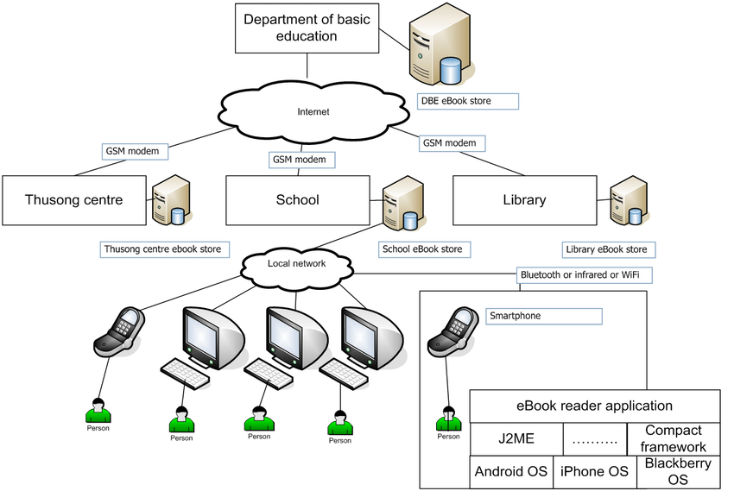
Architecture Diagram

Slide 12
Explanation of Architecture Diagram
1)User Interface Layer – Students, teachers, and administrators interact with the system through a web or mobile app.
2)Input & Upload Module – Users upload textbooks, reference books, or e-books (PDF, text, metadata).
3)Analysis Engine – The core of the system that performs:
Readability check (NLP algorithms).
Content quality analysis (accuracy, relevance, references).
User feedback collection (ratings, reviews).
4)Database Layer – Stores textbooks, assessment results, and feedback for future reference.
5)Admin Console – Used by experts (e.g., NCISM committee) to set evaluation criteria, monitor results, and update the quality scale.
6)Report Dashboard – Generates a clear quality assessment score/report to help students select standard textbooks.

Slide 13
Modules
Input Module: Upload textbook/e-book, metadata, or URL.
Readability Analysis Module: NLP algorithms for readability score.
Content Quality Module: Checks accuracy, references, structure.
User Feedback Module: Collects ratings from students/teachers.
Report Generation Module: Creates a comprehensive quality assessment report.
Admin/Review Module: Monitors system and updates evaluation criteria.

Slide 14
Software Requirements
Operating System: The application can run on Windows 10/11, macOS, or Linux.
Frontend: Built using React.js or Angular with HTML5, CSS3, and JavaScript for user interface.
Backend: Uses Node.js with Express.js, or Python with Django/Flask, for application logic.
Database: Stores data in MySQL, PostgreSQL, or MongoDB.
Hosting & Deployment: Hosted on cloud platforms like AWS, Azure, or Google Cloud or Github

Slide 15
Hardware Requirements
Processor: Intel i5 or AMD Ryzen 5 (or higher) for smooth performance.
RAM: Minimum 8 GB (16 GB recommended for better speed).
Storage: At least 256 GB SSD (512 GB preferred for efficiency).
Graphics: Works with either integrated or dedicated GPU.
Internet: Minimum 2 Mbps broadband connection for cloud-based access.

Slide 16
Software
Software:
Frontend: Angular / React / Flutter
Backend: Node.js / Django
Database: MySQL / Firebase
NLP Tools: NLTK, SpaCy, TextBlob
IDE: VS Code / PyCharm

Slide 17
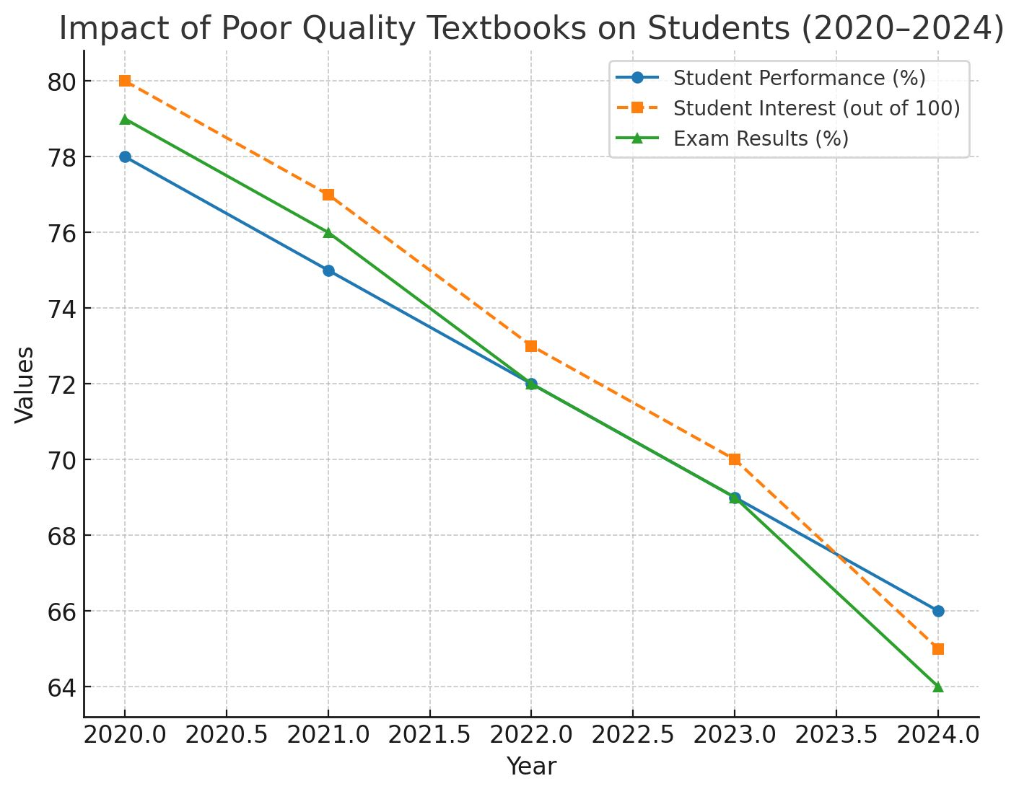
Analysis Through Line Chart ✅

Slide 18
Github Link
The Github link provided should have public access permission.
Github Link
https://github.com/preetu1912/APPLICATION-FOR-ASSESSMENT-OF-QUALITY-OF-TEXTBOOK-REFERENCE-BOOK-E---BOOKS

Slide 19
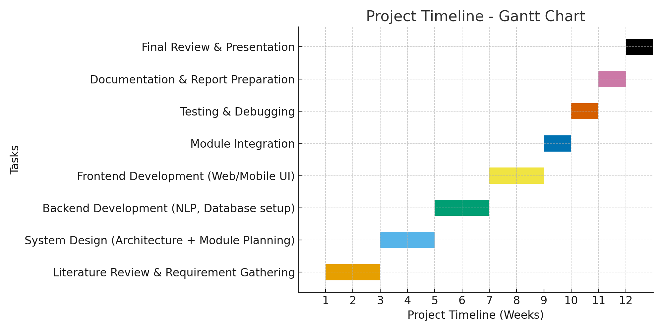
Timeline of the Project

Slide 20
References (IEEE Paper format)
1)P. V. Suresh and R. J. Jeslin, “Exploring e-Books Evaluation: Issues, Evaluation Criteria and Techniques,” International Journal of Engineering Research and Technology (IJERT), vol. 12, no. 7, pp. 1–6, Jul. 2023. [Online]. Available:
https://www.researchgate.net/publication/391509334_EXPLORING_E-BOOKS_EVALUATION_ISSUES_EVALUATION_CRITERIA_AND_TECHNIQUES
2)A. Gurung and R. E. Landrum, “Predicting Textbook Reading: The Textbook Assessment and Usage Scale (TAUS),” Teaching of Psychology, vol. 41, no. 2, pp. 159–167, Apr. 2014. [Online]. Available:
https://www.researchgate.net/publication/270198339_Predicting_Textbook_Reading_The_Textbook_Assessment_and_Usage_Scale

Slide 21
3)K. Nandhini and M. Sivagami, “Quality Textbook Assessment System (QTAS),” International Journal of Advanced Research in Science, Communication and Technology (IJARSCT), vol. 3, no. 1, pp. 1020–1025, Apr. 2024. [Online]. Available:
https://ijarsct.co.in/Paper18102.pdf

Slide 22


